Slide 1
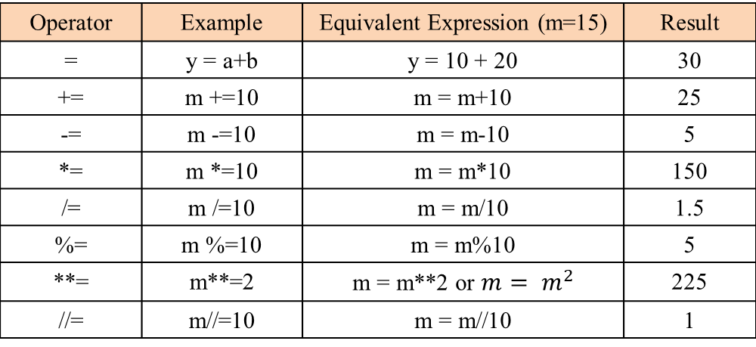
Assignment Operators
Assignment operators are used to perform arithmetic operations while assigning a value to a variable.
Operator | Example | Equivalent Expression (m=15) | Result
= | y = a+b | y = 10 + 20 | 30
+= | m +=10 | m = m+10 | 25
-= | m -=10 | m = m-10 | 5
*= | m *=10 | m = m*10 | 150
/= | m /=10 | m = m/10 | 1.5
%= | m %=10 | m = m%10 | 5
**= | m**=2 | m = m**2 or $m= m^{2}$ | 225
//= | m//=10 | m = m//10 | 1

